Slide 1
Team 5
Project Proposal Presentation
Ruoning Ren/Huangshuai Shi/Jiahui Xi
04/21/2022

Slide 2
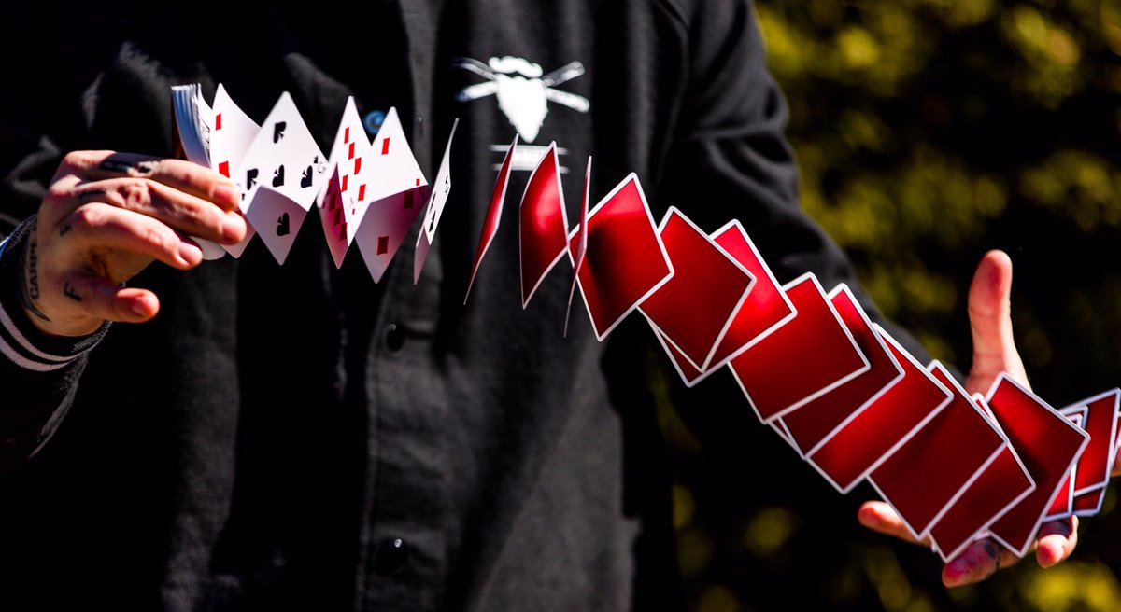
Introduction & Overview
Card Spring
It is a card flourishing technique.
Basically makes a deck of cards spring out of a performer’s hand.

Slide 3
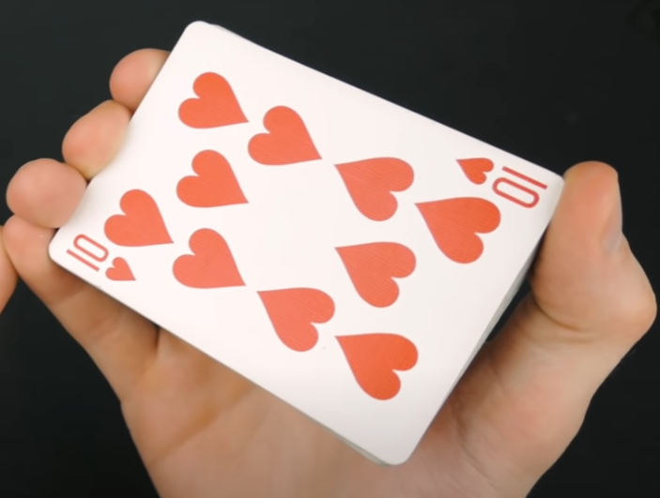
How it’s done
Hold the deck like shown on the right.
Place the thumb across from the pinky on the diagonal of the deck.

Slide 4
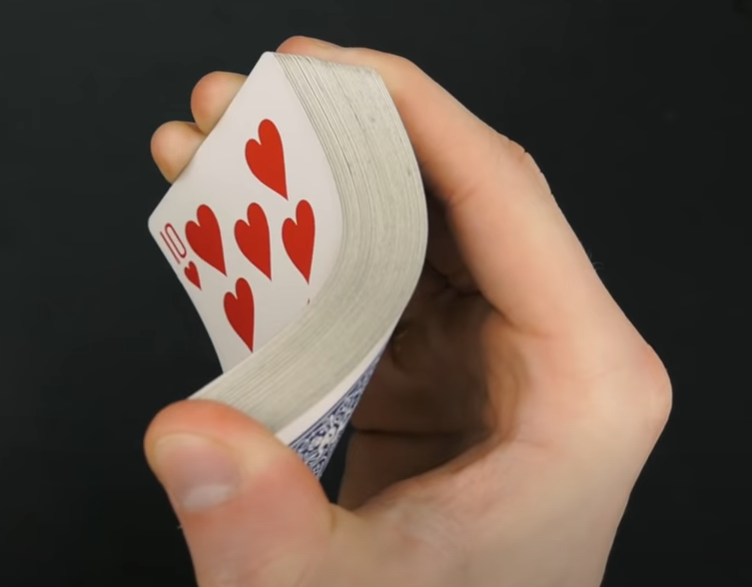
How it’s done
Apply pressure to one side of the deck and the corner across the diagonal on the other side.
Then slightly release pressure on both sides to allow each card to spring out.

Slide 5
Objectives
Model the card spring with what we learn from the class
Simulation Methods considered
Discrete elastic rods
Discrete elastic shells

Slide 6
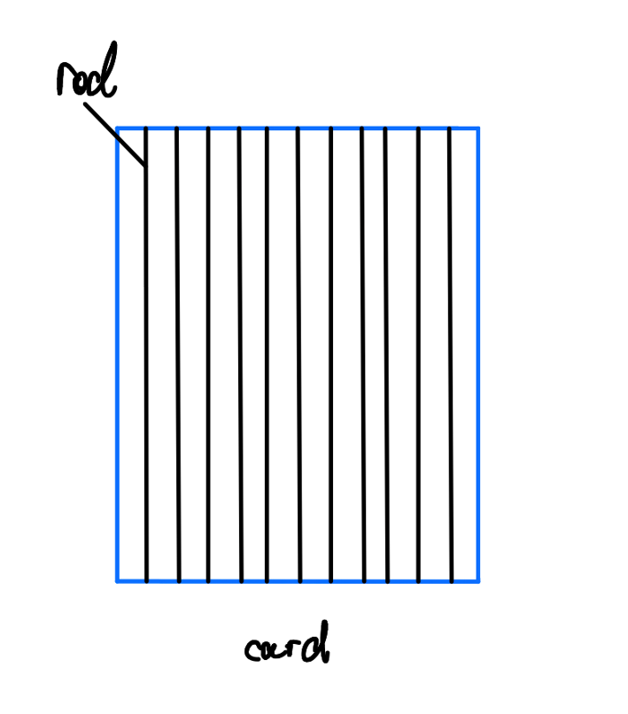
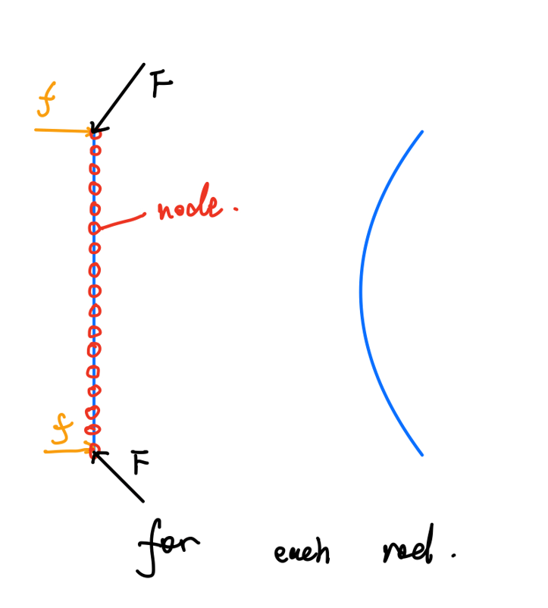
Discrete Elastic Rods
A composition of multiple parallel rods / every rod bears bending force and friction
Notes:
Discrete elastic rods
Since the real card spring process is a bit complicated, we plan to firstly consider it as composition with multiple rods and every rod bears bending force and friction.
Then remove the friction at a specific time step, and decrease the bending force at next several time steps. Also, free the fixed value of the node's position. Those rods will be ejected from the initial position

Slide 7
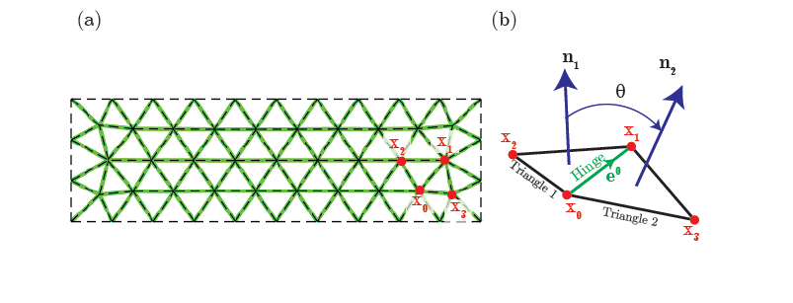
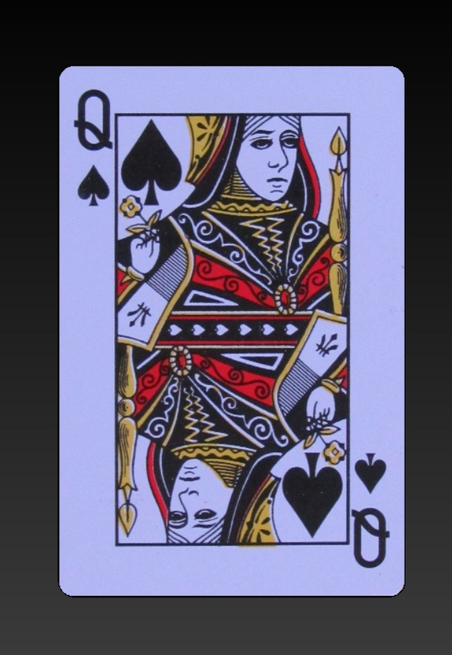
Discrete Elastic Shells
All edges, except the ones on the boundary of the structure, are hinges. Each hinge is associated with four nodes: x0, x1, x2, and x3. Here x2 and x3 can bend

Slide 8
Deliverables
a. a video clip about discrete elastic rods method with constant load distribution.
b. a video clip about discrete elastic rods method with function controlled load distribution.
c. a video clip about discrete elastic shell method with constant load distribution.

